Slide 1
Code complexity
Eng. Abdelrahman Abdelmoez Ahmed

Slide 2

Code complexity
1- Time complexity
2- Space complexity

Slide 3
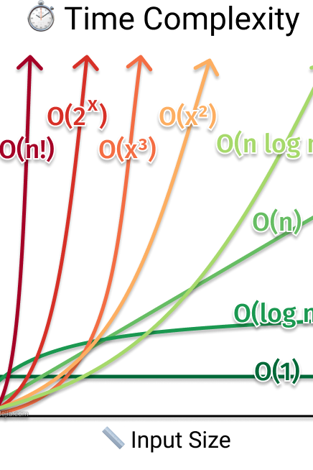
Time complexity
The time it will take the device to execute the code, based on :
Constant time
Linear time
Quadratic time
Logarithmic time

Slide 4
Constant time O(1)
------------------------------
def print_first_element(lst):
print(lst[0])
-------------------------------------------------
This means that the code takes a fixed amount of time that never changes with the size of the data, no matter how different it is.
In this function it takes a O(1) what ever the amount of lst

Slide 5
Linear time (o(n))
-----------------------------
def print_list(lst):
for item in lst:
print(item)
-----------------------------
The execution of the code is directly proportional to the size of the data in the same proportion.
In this function that takes time according to the number of lst

Slide 6
Quadratic Time (o(n^2))
------------------------
def print_pairs(lst):
for i in lst:
for j in lst:
print(i, j)
------------------------
means that the number of operations in the code increases as a square of the data size
That shows in nested loop Because it is compare between each element to other.

Slide 7
Space complexity

Slide 8
Logarithmic Time (O(log n))
def binary_search(lst, target):
low = 0
high = len(lst) - 1
while low <= high:
mid = (low + high) // 2
if lst[mid] == target:
return True
elif lst[mid] < target:
low = mid + 1
else:
high = mid - 1
return False
The number of steps increases logarithmically with the size of the data.
In this function: each turn the data split to half so number of turns =log(n)
It is show in Binary search Tree and Merge sort

